Slide 1
Reversing a String Using Stack in C
Mohammad Ali Nayeem — ID: 232-35-022
Software Engineering Student
Daffodil International University

Slide 2

Introduction
This presentation demonstrates how to reverse a string using stack data structure in C.
The concept utilizes Last-In-First-Out (LIFO) property of stacks to reverse the order of characters.

Slide 3
Stack Concept
• Stack is a linear data structure.
• Follows Last-In-First-Out (LIFO) principle.
• Push operation: Insert element into stack.
• Pop operation: Remove element from stack.
• In string reversal, characters are pushed then popped to reverse order.

Slide 4
Algorithm for Reversing a String
1. Read the input string.
2. Push each character onto the stack.
3. Pop characters from the stack and store back into the string.
4. Print the reversed string.

Slide 5
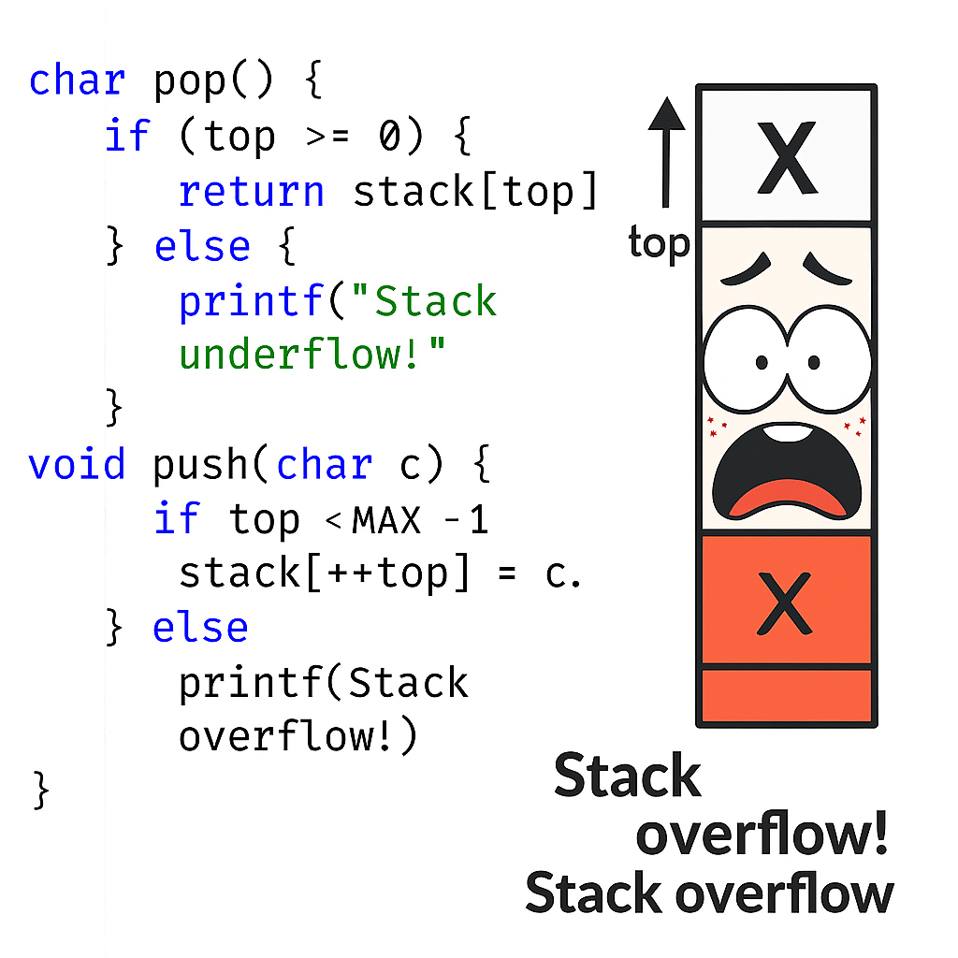
C Code Example

Slide 6
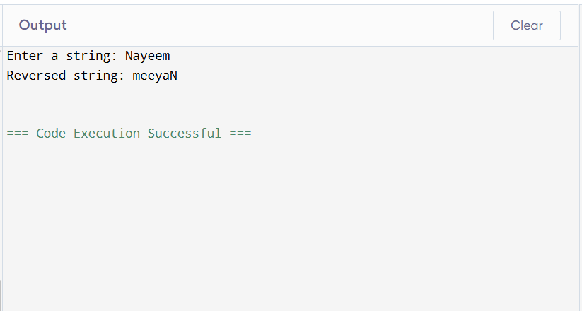
Example Output

Slide 7

Conclusion
• Using a stack makes string reversal simple.
• Demonstrates stack's LIFO property.
• This method can be extended to other data processing problems.

Slide 8


